Slide 1

Customer Churn Prediction for Telecom Industry

Slide 2
Objective: Predict churn and derive actionable strategies to retain users in a highly competitive telecom environment.
Goals:
Identify key drivers of churn using machine learning.
Segment customers for targeted retention strategies.

Slide 3
Dataset Overview
Source: Telco Customer Churn dataset (Kaggle).
Details:
7,043 customers, 21 features (e.g., tenure, MonthlyCharges, Contract, Churn).
Churn Distribution (from plot):
~73% No Churn (5,174 customers).
~27% Churn (1,869 customers).
Imbalanced dataset; focus on recall for churn class.
Key Insight: High churn rate indicates a need for proactive retention strategies.

Slide 4
Methodology
Steps:
Data Aggregation: SQL to compute metrics (e.g., average tenure, total charges).
Model: Random Forest Classifier (Scikit-learn).
Explainability: ELI5 for feature importance, SHAP for individual prediction insights.
Segmentation: K-Means clustering (At Risk, Loyal, Dormant).
Tools: Python, Scikit-learn, ELI5, SHAP, executed in VS Code.

Slide 5
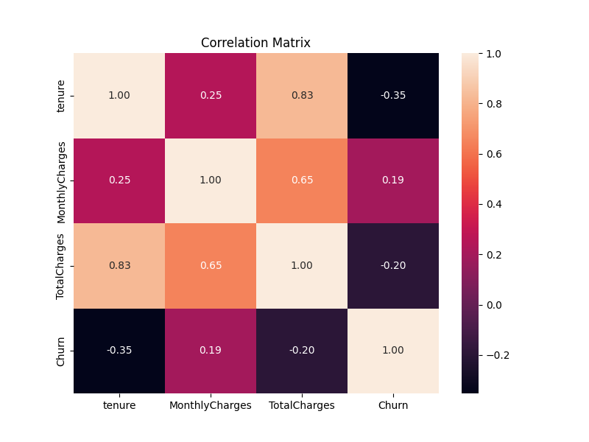
Exploratory Data Analysis
Churn Distribution:
27% of customers churned, indicating a significant retention challenge.
Visual: Include the "Churn Distribution" plot (5,174 No, 1,869 Yes).
Correlation Matrix:
Tenure vs. Churn: -0.35 (longer tenure reduces churn likelihood).
MonthlyCharges vs. Churn: 0.19 (higher charges increase churn risk).
TotalCharges vs. Tenure: 0.83 (strong correlation, longer tenure leads to higher total charges).

Slide 6
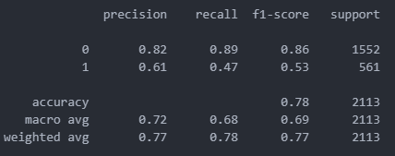
Model Performance
Model: Random Forest Classifier.
Metrics (from previous output):
Accuracy: ~78%.
AUC-ROC: ~0.82 (good discriminative power).
Recall for Churn (Yes): ~0.50 (effective at identifying churners).
Insight: Model is reliable for predicting churn, with a focus on identifying at-risk customers.

Slide 7
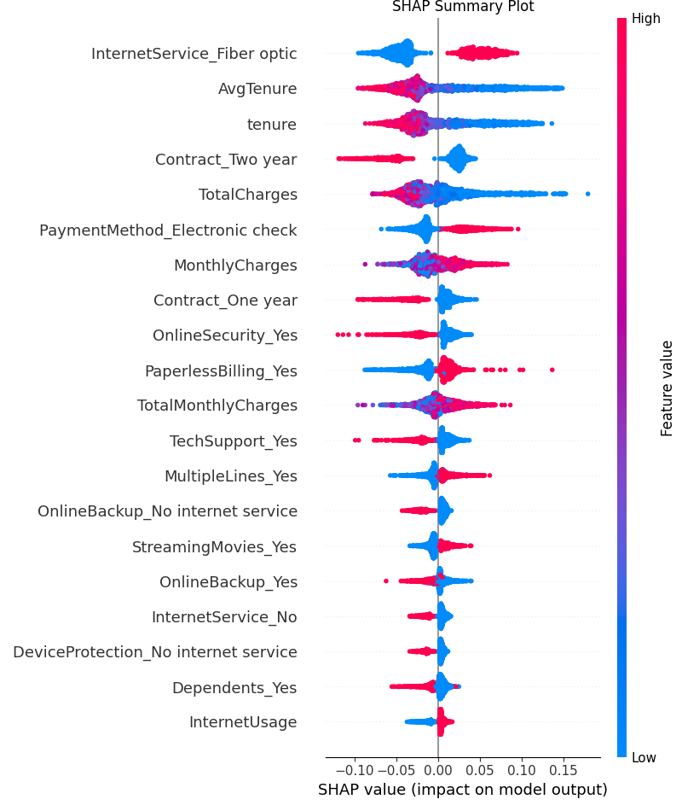
Key Drivers of Churn (Explainability)
SHAP Summary Plot:
Top Features Increasing Churn (High SHAP Values):
InternetService_Fiber optic: Fiber optic users more likely to churn (possibly due to cost or service issues).
AvgTenure (low values): Short tenure strongly predicts churn.
Contract_Two year (low presence): Lack of long-term contracts increases churn risk.
MonthlyCharges (high values): Higher charges push customers to churn.
Features Reducing Churn (Low SHAP Values):
OnlineSecurity_Yes: Security services reduce churn likelihood.
Contract_One year: Annual contracts lower churn risk.
TechSupport_Yes: Access to tech support decreases churn.

Slide 8
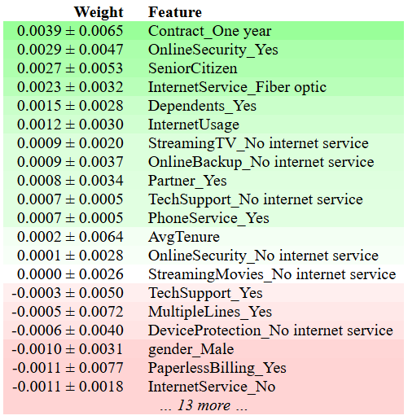
ELI5 Feature Importance:
Top Features by Weight:
Contract_One year (0.0039 ± 0.0065): Strongest predictor; annual contracts reduce churn.
OnlineSecurity_Yes (0.0029 ± 0.0047): Security services retain customers.
SeniorCitizen (0.0027 ± 0.0053): Senior citizens may have higher churn risk.
InternetService_Fiber optic (0.0023 ± 0.0032): Fiber optic users at higher risk.

Slide 9
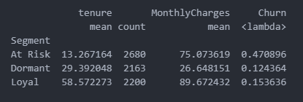
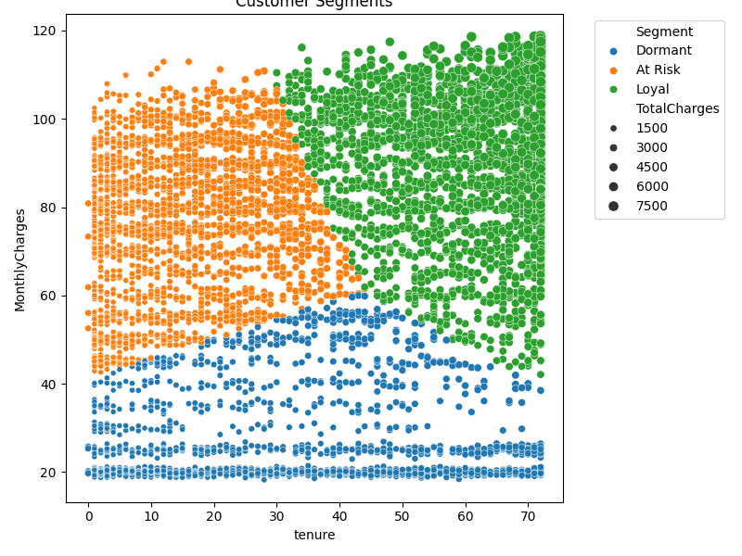
Customer Segments
Segmentation Approach: K-Means clustering on tenure, MonthlyCharges, TotalCharges.
Segments (from previous analysis):
At Risk: Short tenure, high charges, ~47% churn rate.
Loyal: Long tenure, stable payments, ~15% churn rate.
Dormant: Low service usage, ~13% churn rate.
Insight: At Risk customers need immediate intervention; Loyal customers should be rewarded.

Slide 10
Recommendations
Engage Dormant Customers:
Promote bundled services (e.g., Internet + Streaming) to increase usage.
Offer limited-time promotions to re-engage low-usage customers.
Retain Loyal Customers:
Provide exclusive benefits (e.g., priority support, loyalty discounts).
Introduce referral programs with incentives.
Operational Improvements:
Monitor tenure and MonthlyCharges for early churn detection.
Enhance tech support and online security offerings to retain customers.

Slide 11
Conclusion
Summary:
Built a reliable churn prediction model (AUC-ROC ~0.82).
Identified key drivers: short tenure, high charges, fiber optic service, and contract type.
Segmented customers for targeted retention strategies.

